Slide 1

BOOKS TO MOVIES
Presented by Eric Sanders
January 2026

Slide 2

ONCE UPON A TIME…….
I grew up exploring – the tops of trees, the water in the lake, the tardigrade in the moss off the top of the house, the forest and the beach. And I love puzzles – wooden puzzles, Legos, Sudoku, Hack Pack, three-dimensional puzzles. I went to Eckerd college and majored in Physics. I got involved in non-profit work by managing the back of the house for a food bank. But that was a puzzle, it was just called inventory management. Along the way, I attended a coding camp and realized that data analytics was the puzzle that I wanted to work on so here I am.

Slide 3
INTRODUCTION
This project was born out of my love of books and my frustration that sometimes movies made from books that I love turn out great while others do not. With this project, I tried to answer whether a book’s rating on GoodReads was an indicated of whether a movie made from the book would be good.
I also wanted to know if there was a time limit for a book to be made into a movie.
Did some directors fair better at making a movie from a book then others, and therefore, could that be a predictor of how the movie would be rated?
I also was curious if there was a trend where some authors’ books made better films.

Slide 4



Data collection
This project began with web-scraping a Wikipedia article on works of fiction that were turned into films.
To have a manageable amount of data, only films released from 2001 to 2025 were used.
That data was then used to filter out the books that I needed from a data set that was scraped from Goodreads by Zygmuntz in 2017.
The films that were made from those books was compared to data scraped from IMDb and data sets from IMDb.

Slide 5
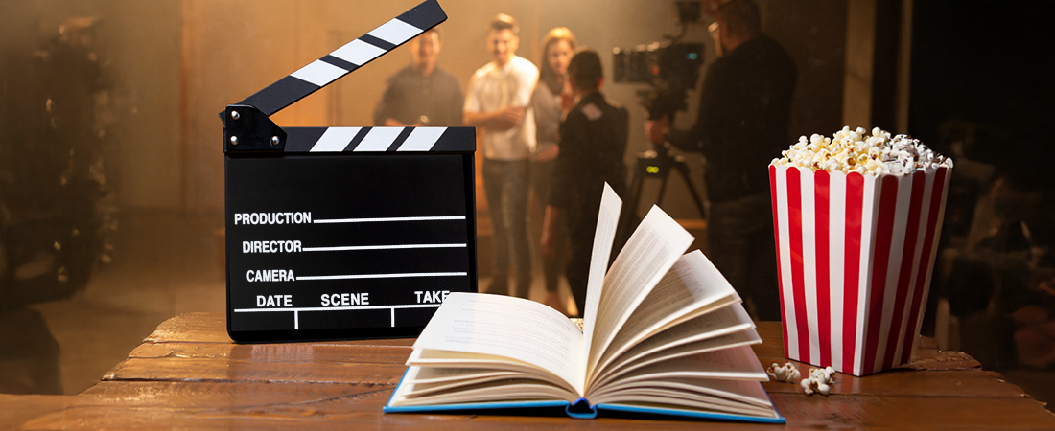
Books have been a source for movies since movies began, but…..

Slide 6
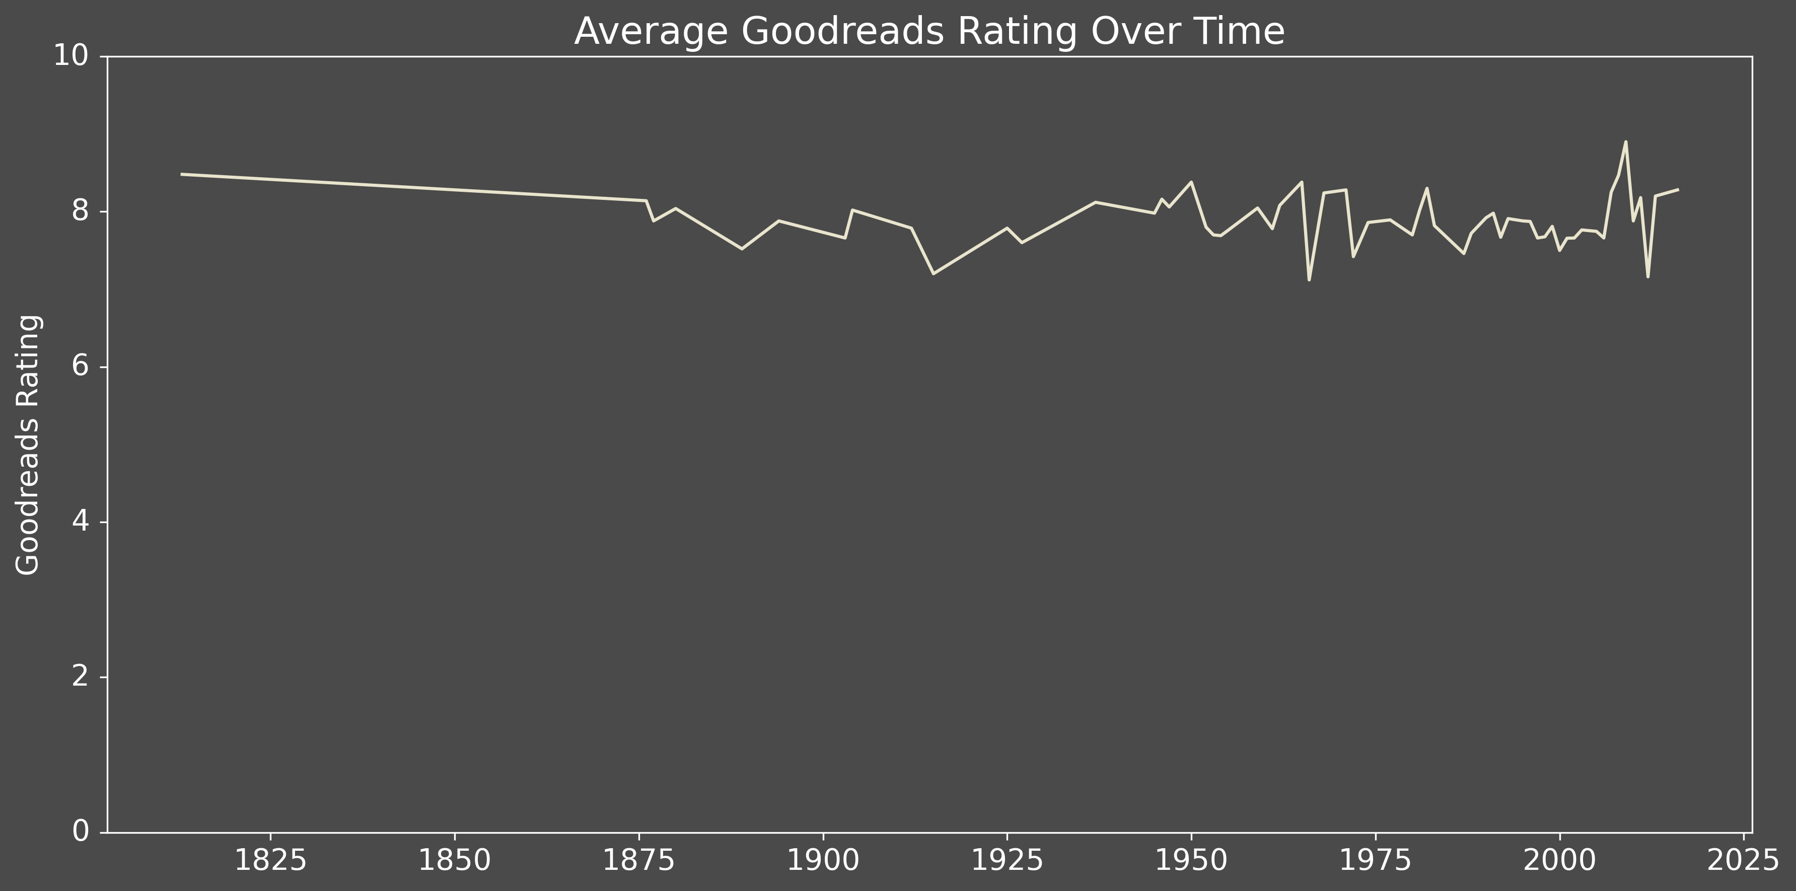
What kind of books?
The books that have been used to make movies have, on the average, been rated 8 out of 10 by readers. So it’s safe to assume, that popular and highly rated books are considered for movies.

Slide 7
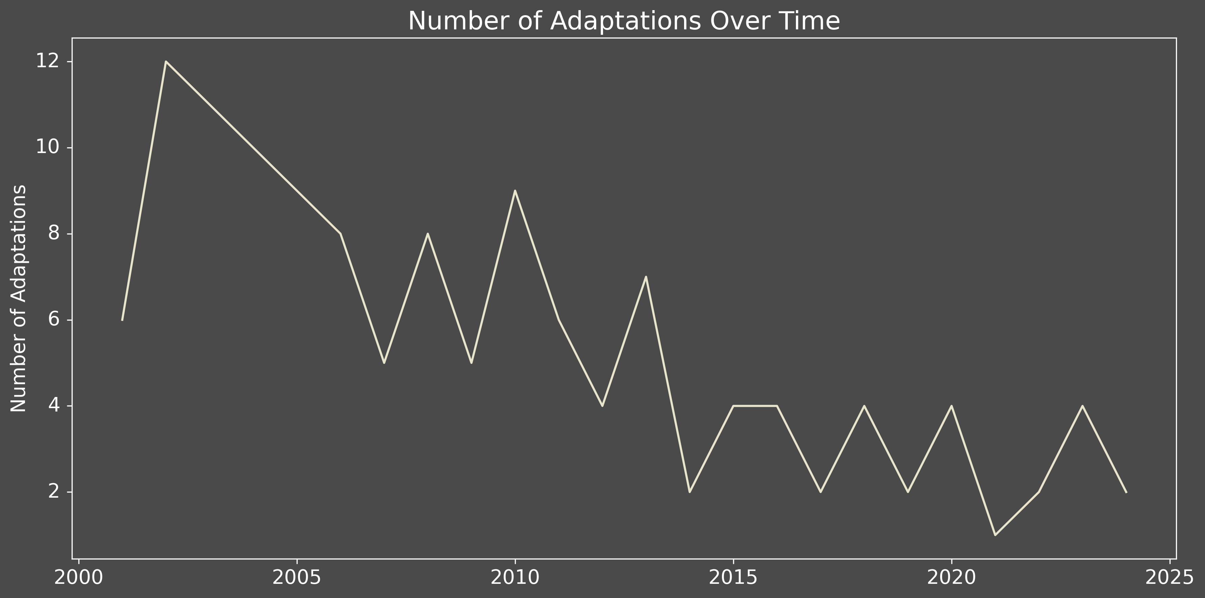
Are books being used at the same rate?
Over the last 25 year, the number of movies that have used books as their primary source has declined.

Slide 8
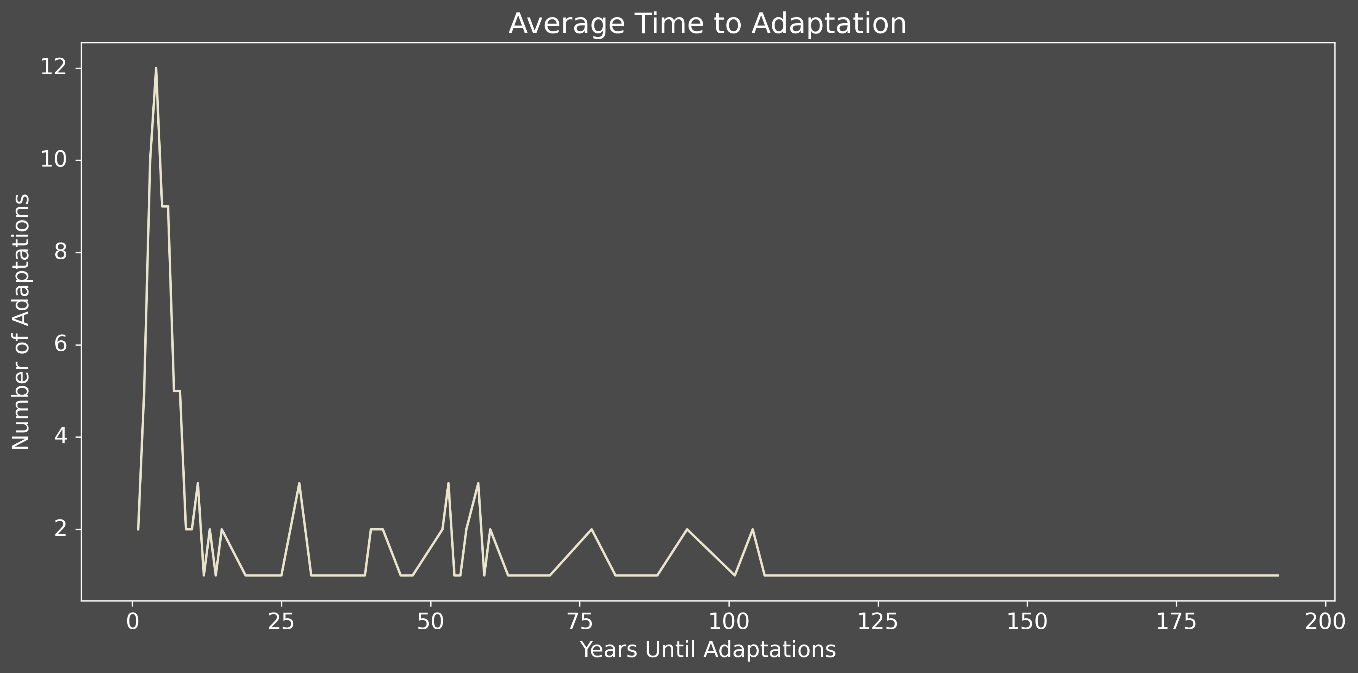
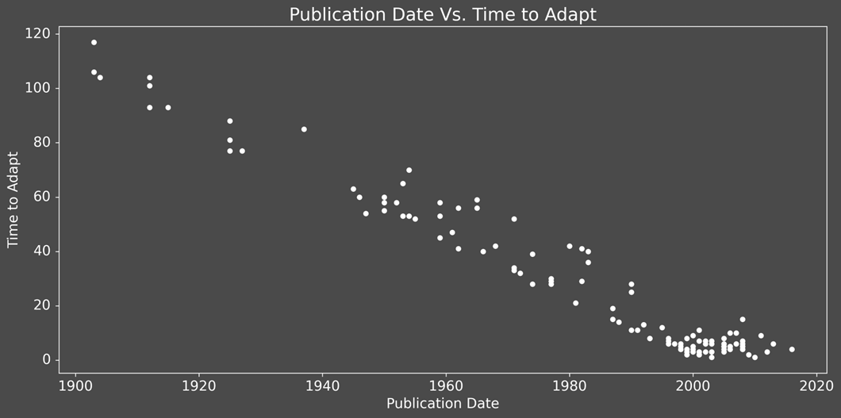
How long does it take to turn a book into a movie?
In the early days of cinematography, the books that were used had been published years earlier. By the 2000s, books that were turned into moves happened within about 5 years of publication. If an author has not sold the movie rights within 5 years of publication, they are much less likely to get a movie deal.

Slide 9
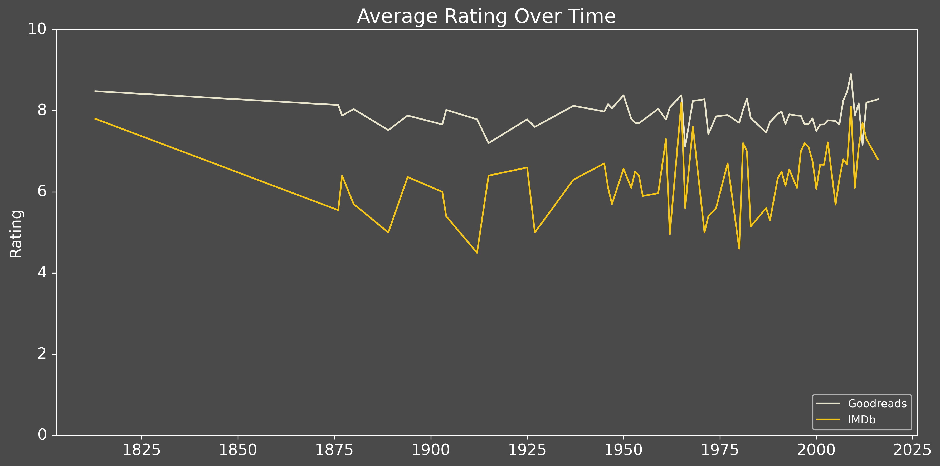
How are those movies rated in comparison to the book’s rating?
The books that have been used have had a steady rating of approximately 8. Movie ratings, since the 1900s have been about a 6 with wider variation. There is a trend of movie ratings going up in the past decade.

Slide 10
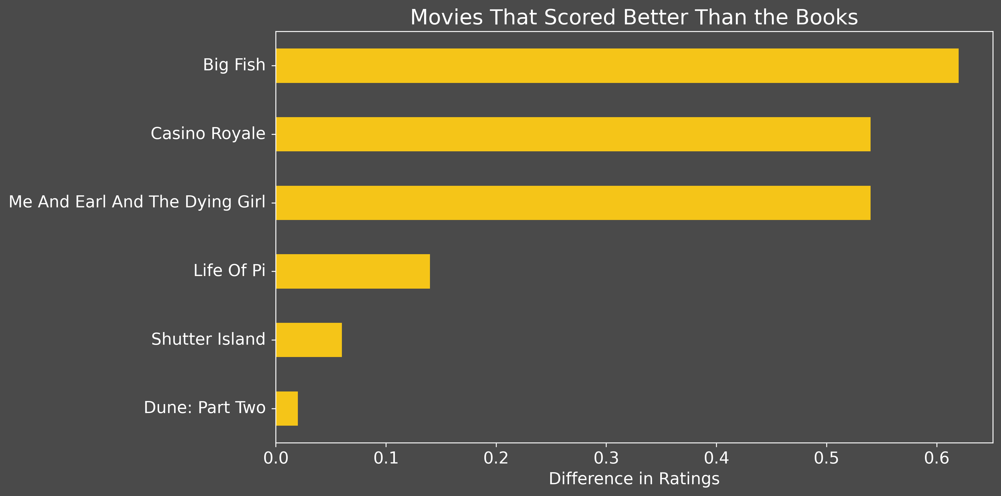
Are Some movies are better than the books?
Yes, but less than 5 percent of movies get ratings that are higher than the books they are based upon.

Slide 11
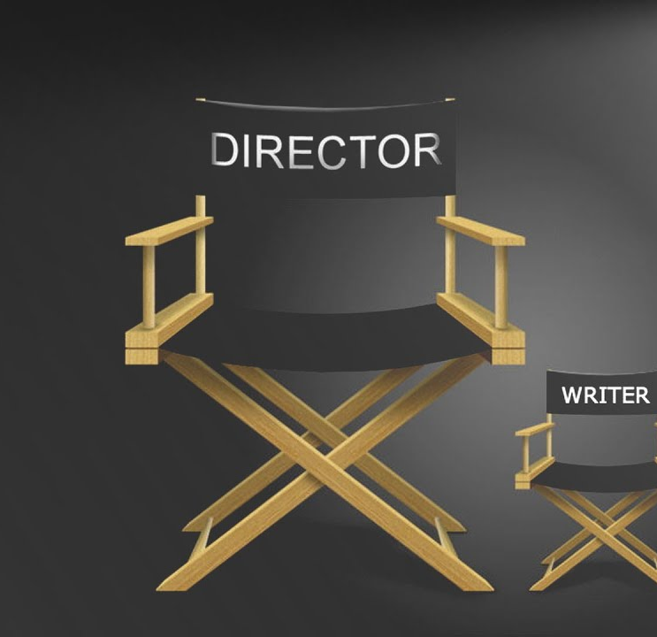
Author vs director
Next, let’s compare authors and directors to see who has the most impact.

Slide 12
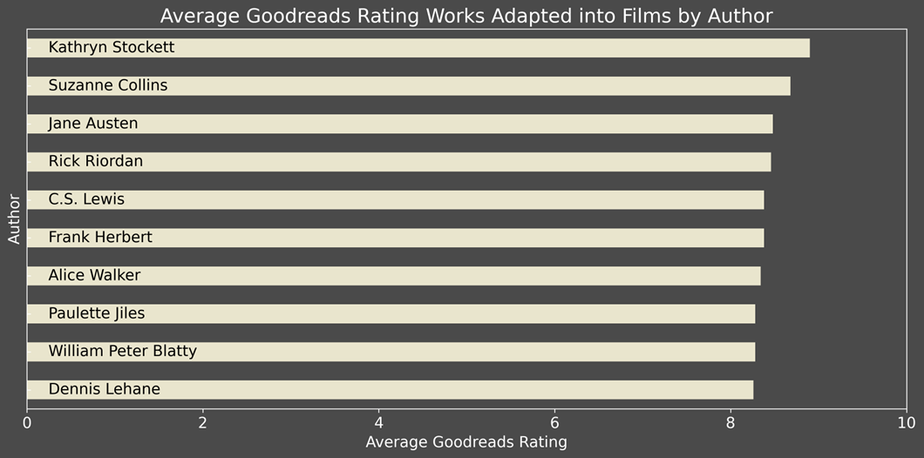
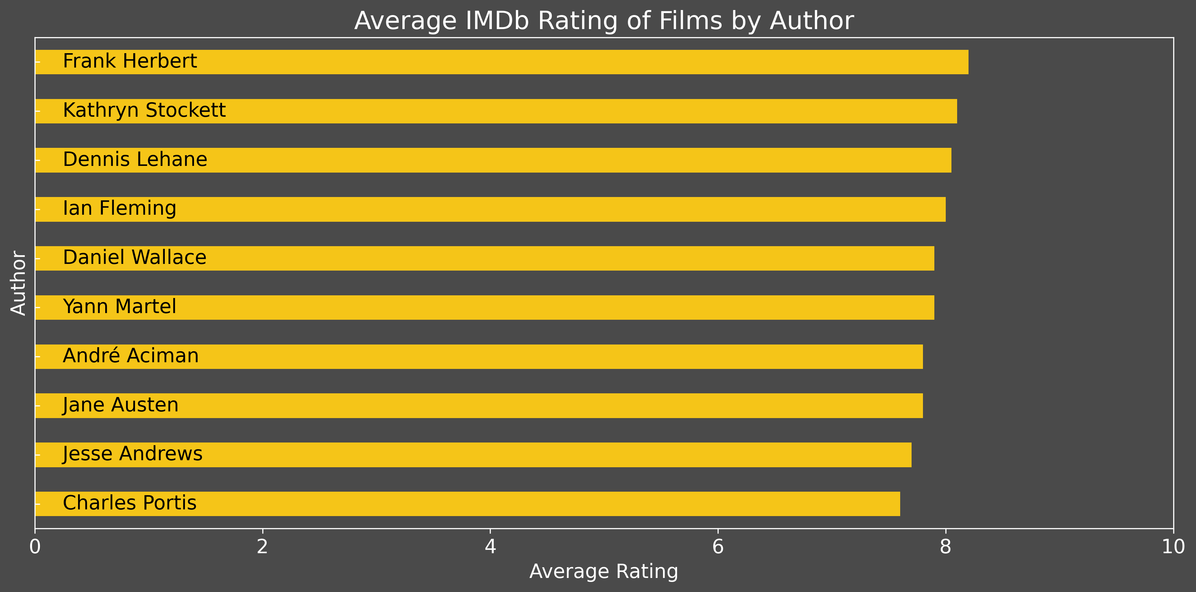
Of the top 10 movie ratings and the top 10 book ratings, there are 4 who overlap
The first graph shows the authors with the highest ratings for their books on Goodreads. The second graft shows the authors who’s adapted films had the highest IMDb scores. You will notice there are four that overlap – Jane Austen, Dennis Lehane, Frank Herbert, and Kathryn Stockett.

Slide 13
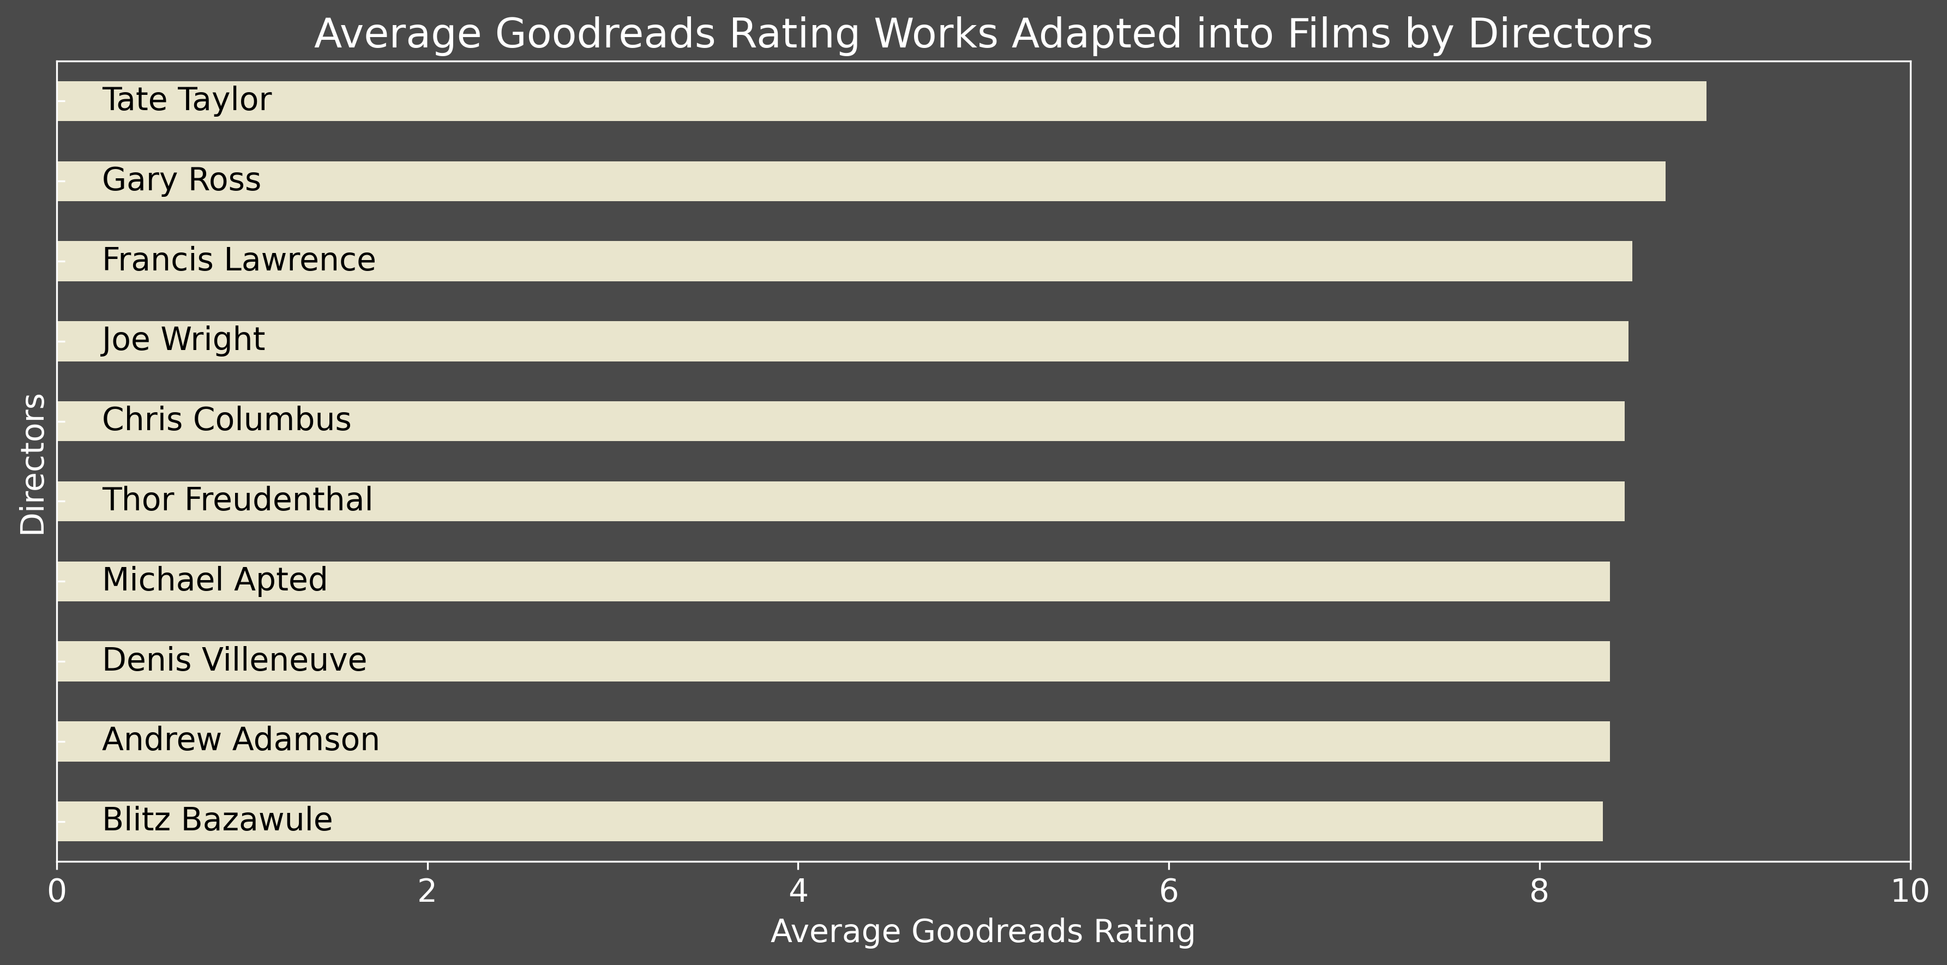
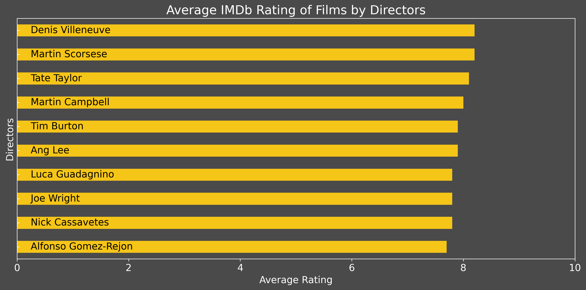
Directors influence whether a book maintains it’s good rating when adapted to a movie.
In comparing the ratings of the books used and the films by the Directors that made the films, three directors stand out as having used books with top ratings and their films received top ratings. They are Tate Taylor, Joe Wright, and Denis Villeneuve.

Slide 14
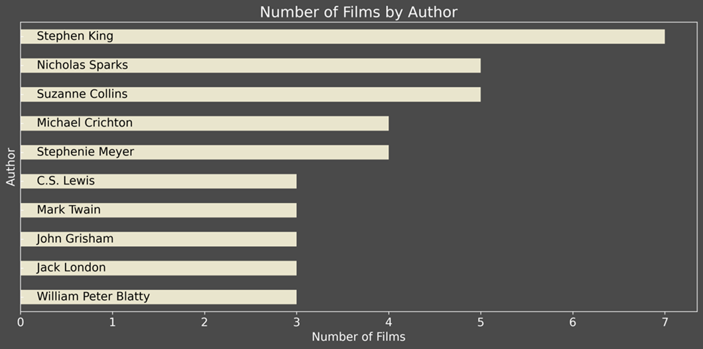
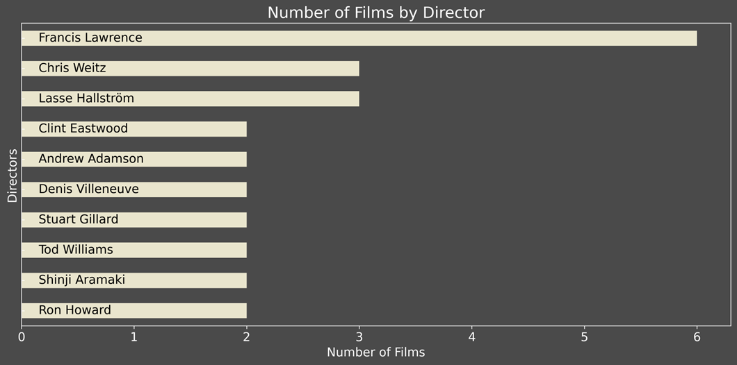
A good series seems to make a big difference….. Unless you are Stephen King.
In comparing number of films, one author and one director come out clearly on top – Stephen King and Francis Lawrence. Francis Lawrence owes a lot of his success to the third highest author, Suzanne Collins while Stephen King’s books were all directed by different people none of whom made the list.

Slide 15
conclusions
Movies based on books tend to use books that have higher ratings. Whether that correlates to higher ratings for the movies is weaker since more factors contribute.
When looking at the directors, experience does help. Directors that chose to work on films that are based on proven authors, have a greater likelihood of producing a movie that has a positive rating. However, even for skilled director it appears hard for them to make a movie that exceeds the rating of the book.
While the time between publication and release of a movie does not appear to be a factor, for authors it is clear that it is becoming a shorter turn-around time. Movies are less often being made on books that were published more than 5 years ago. It would appear that the film industry thinks that it has used the majority of the good books from the past.

Slide 16
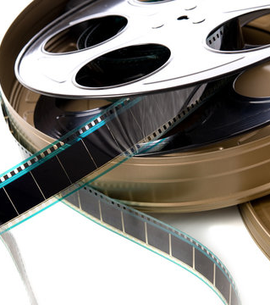
….. Cut! That’s a wrap!

